Slide 1
Mapping Mortality: Predicting Cancer Death rates across America
Sahana Krishna Murthy
Hyunseok Lee
Notes:
Scientific Problem ; Cancer mortality continues to pose a significant public health challenge despite advancements in medical treatments. This study aims to investigate how socioeconomic factors (such as median income and poverty rates), healthcare coverage types, and demographic characteristics influence the target death rate due to cancer across different regions.
By analyzing comprehensive demographic and health-related datasets, we seek to identify key determinants of cancer mortality to inform targeted interventions and policy decisions for improving health outcomes.

Slide 2
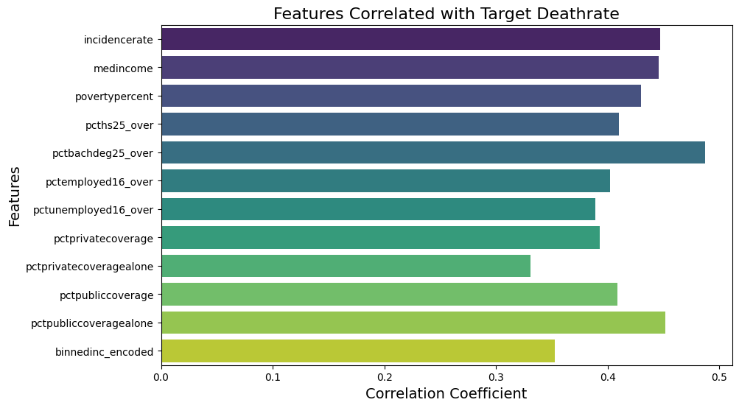
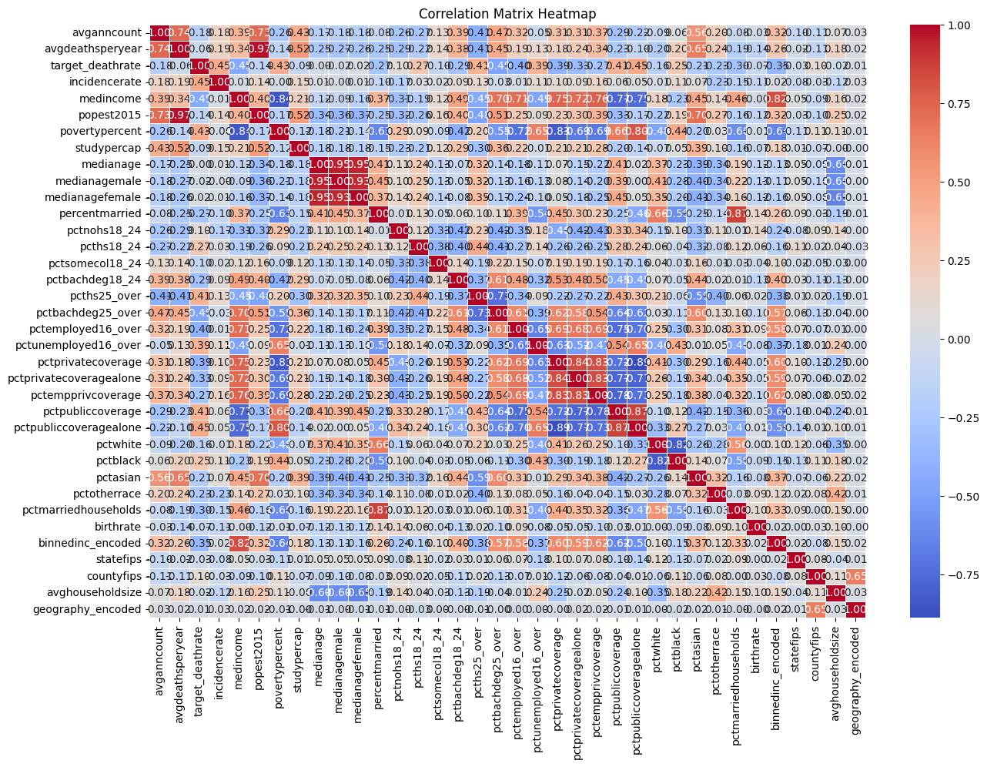
Data Processing & EDA
Data size : Cancer_data : 3047 x 33
Household_data : 3220 x 4
Merge_data : 3047 x 39
target_deathrate
Avganncount and avgdeathsperyear
Incidence Rate
Demographics
Insurance and Employment
Race and Ethnicity
‘Geography’ - applied Label Encoding
Detect Outlier with Boxplots ->
Applied IQR method; numeric -Mean non-numeric-Mode
Find high Correlation with threshold(0.3)
Top 10 features relates to response

Slide 3
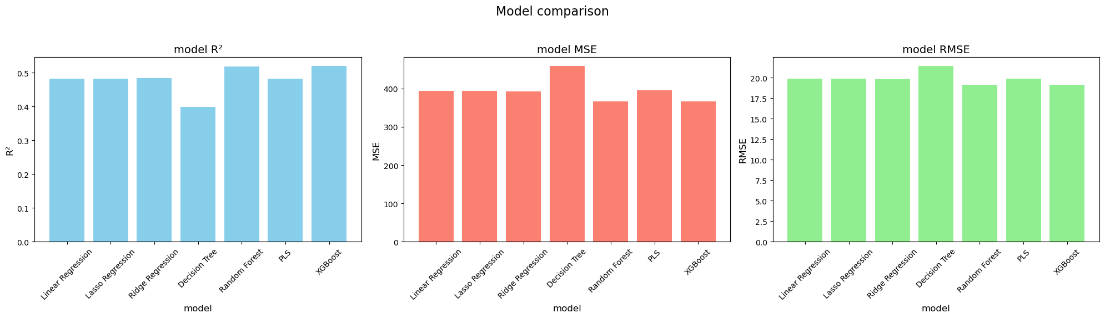
Model Selection
Target variable : Target_deathrate ; continuous
-Train & test data : 8 : 2 ratio w/ scaled
Linear regression
Lasso regression
Ridge regression
Regression Tree
Random Forest
PLS
XGBoost
GridsearchCV &
RandomizedsearchCV
Compare RMSE & R²

Slide 4
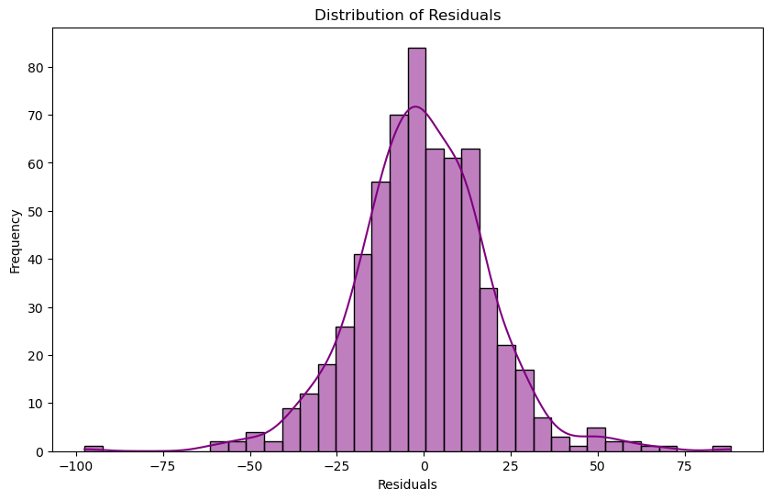
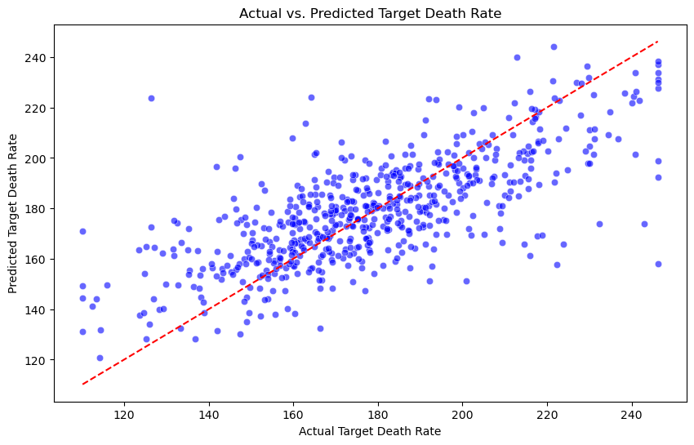
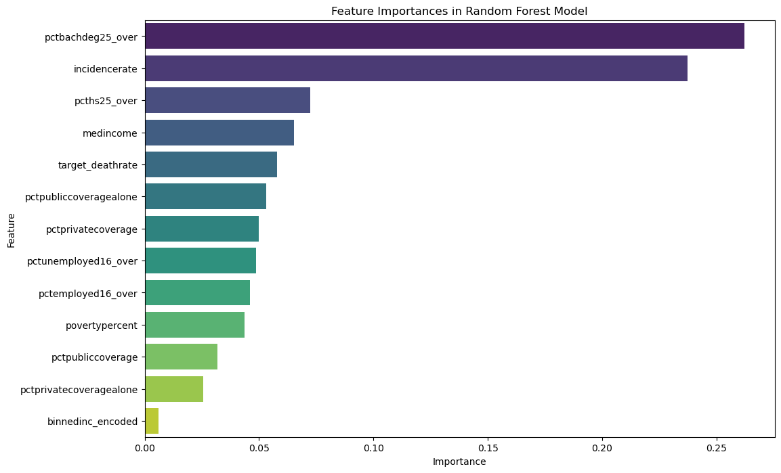
Conclusion
Best Model : RandomForest parameters: {'n_estimators': 100, 'min_samples_split': 5, 'min_samples_leaf': 2, 'max_depth': 20}
Top Features
Percentage of population with a bachelor's degree or higher
Cancer incidence rate
Interpretation:
The Random Forest model places greater importance on education and incidence-related features, which suggests that improving education levels and reducing incidence rates could have the strongest impact on reducing cancer-related deaths.
Lessons Learned
Since R² only present 52% variation, still need more Data
Geographically doesn’t related + Data skewed(race, etc.)

